Slide 1
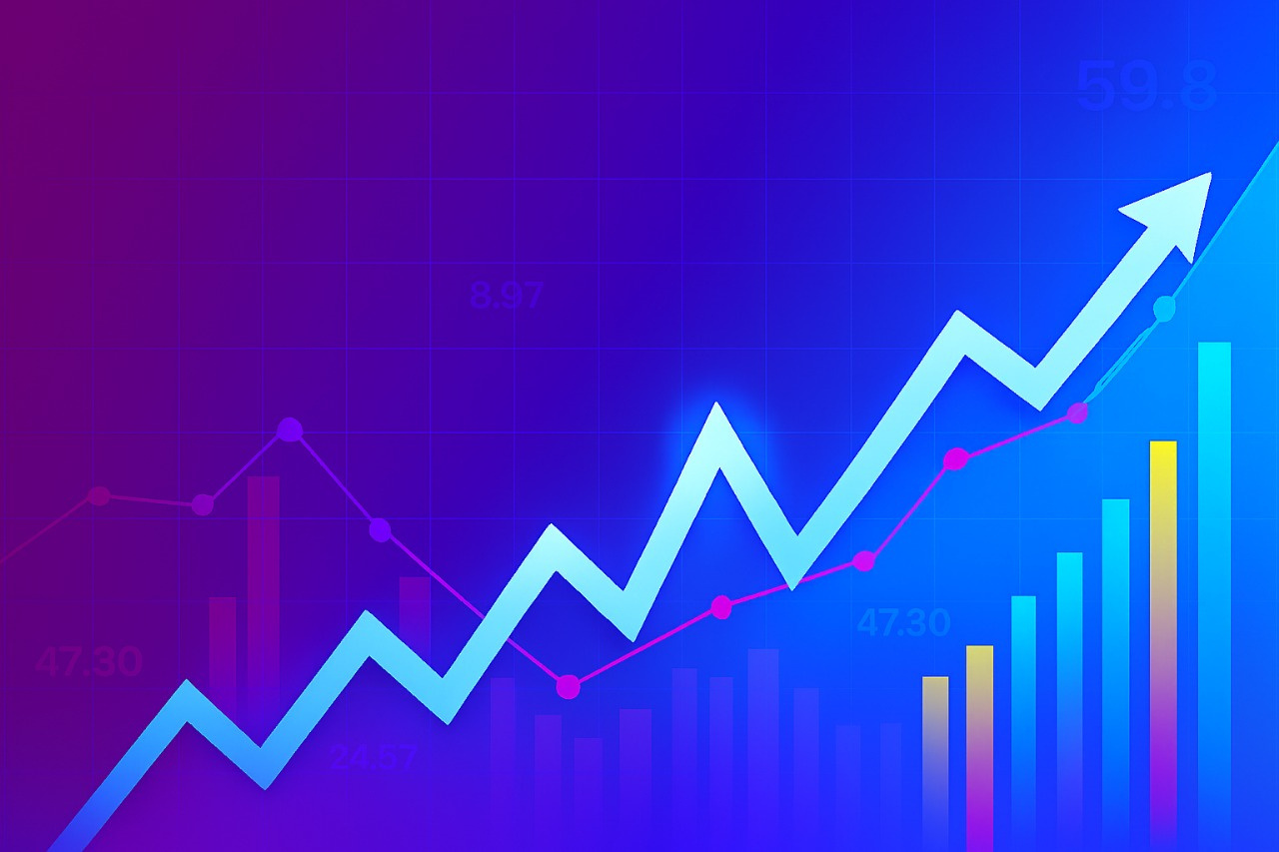
Indian states and union territories by literacy rate
Presented by Yaamini Sree

Slide 2

Problem Statement
Purpose: Explain why this analysis matters
Literacy is a key driver of development and empowerment
Understanding trends helps policy-making and education planning
Focus on historical and recent literacy data for Indian states

Slide 3

Project Objective
To scrape and extract structured literacy rate data from Wikipedia for 2011 Census, NSC 2017, PLFS 2024, and census decades 1951–2011.
To clean and preprocess the data, resolving missing values, formatting inconsistencies, and duplicates.
To calculate key literacy metrics, including average literacy rates, male vs female literacy, and state-wise literacy improvements.
To generate visualizations—maps, line charts, bar charts, pie charts, and scatter plots—for better understanding of trends.
To provide insights into literacy trends, gender gaps, and progress across Indian states/UTs for academic and policy analysis.

Slide 4

Tools & Technologies
Python Libraries:
requests – HTTP requests for web scraping
BeautifulSoup – HTML parsing
random – Random user-agent selection
pandas – Data manipulation and DataFrames
io.StringIO – Reading HTML strings as file-like objects
matplotlib.pyplot – Plotting graphs
seaborn – Statistical data visualization
folium – Interactive maps and geospatial visualization
Platform:
Jupyter Notebook / VS Code

Slide 5
Data Source
Wikipedia Page:
https://en.wikipedia.org/wiki/List_of_Indian_states_and_union_territories_by_literacy_rate
Fields extracted:
State/UT
Literacy rate (2011 Census, NSC 2017, PLFS 2024)
Male Literacy Rate
Female Literacy Rate
Historical Census Literacy (1951–2011)

Slide 6
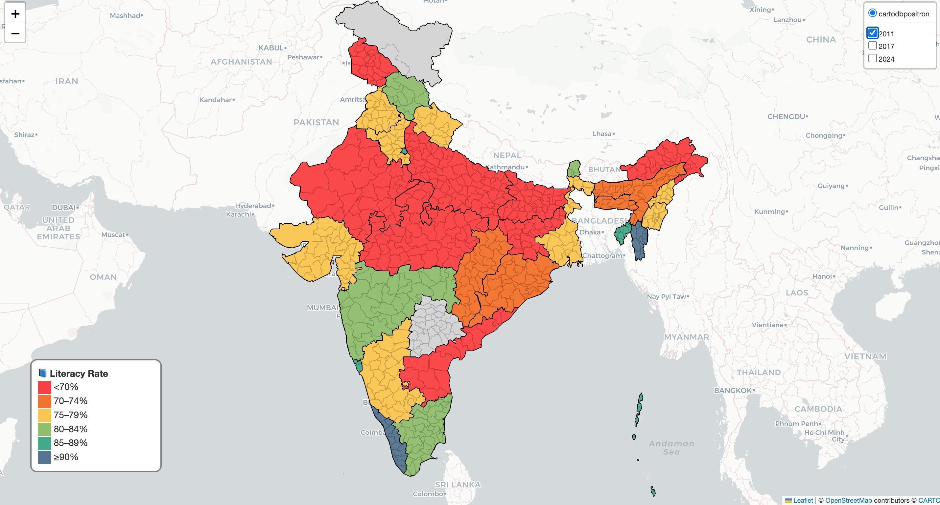
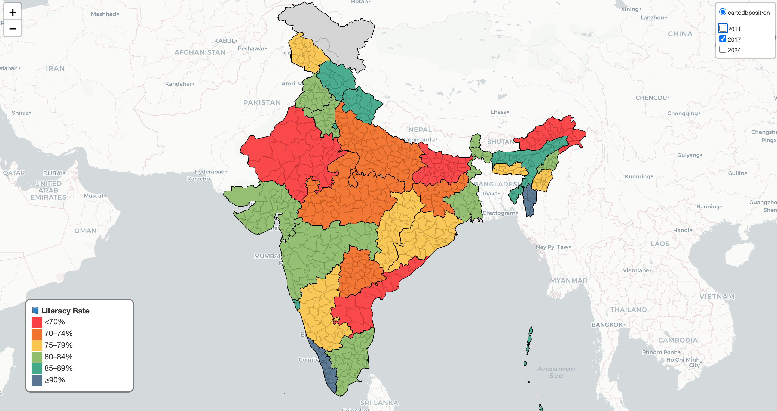
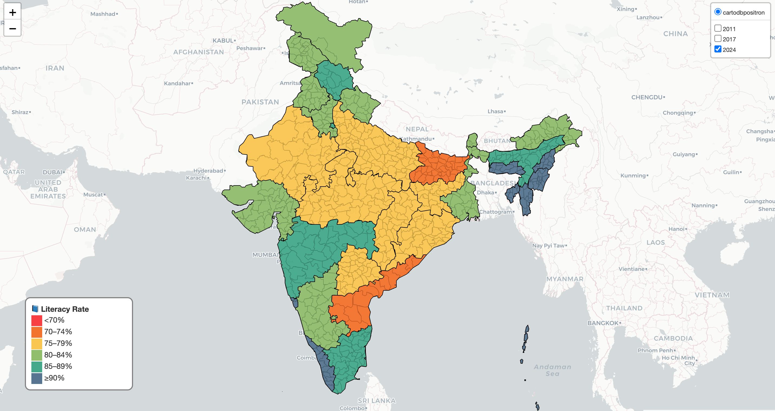
Interactive Choropleth Map (Folium) showing literacy rates for 2011, 2017, and 2024
States with the highest, lowest literacy rates are easily identifiable

Slide 7

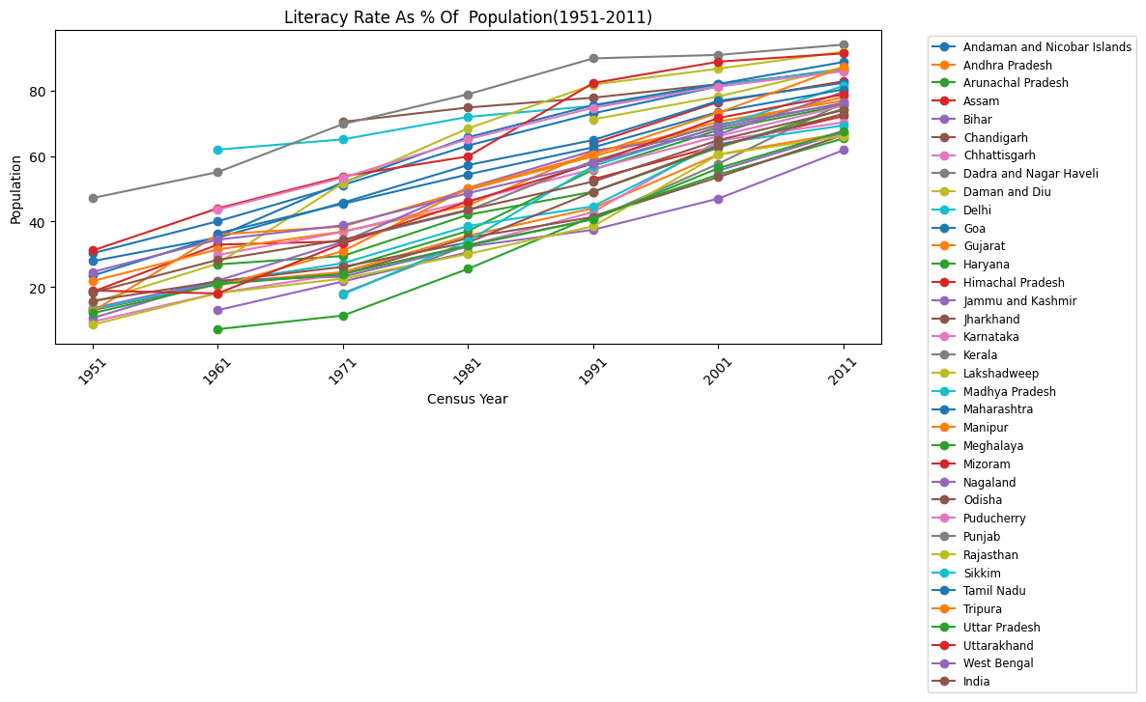
Indian Historical Literacy Trends
Visual: Line Chart Show improvement over time - Census Literacy (1951–2011)
The Indian state literacy rate continues to rise steadily, showcasing the ongoing efforts toward education accessibility and quality, despite challenges that still hinder progress in various regions.

Slide 8
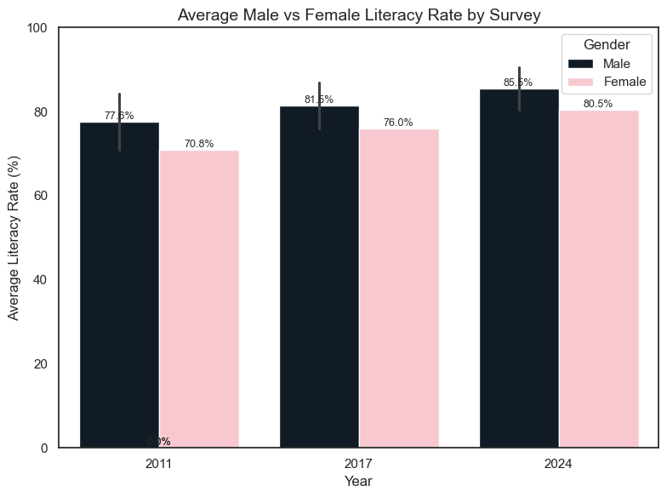
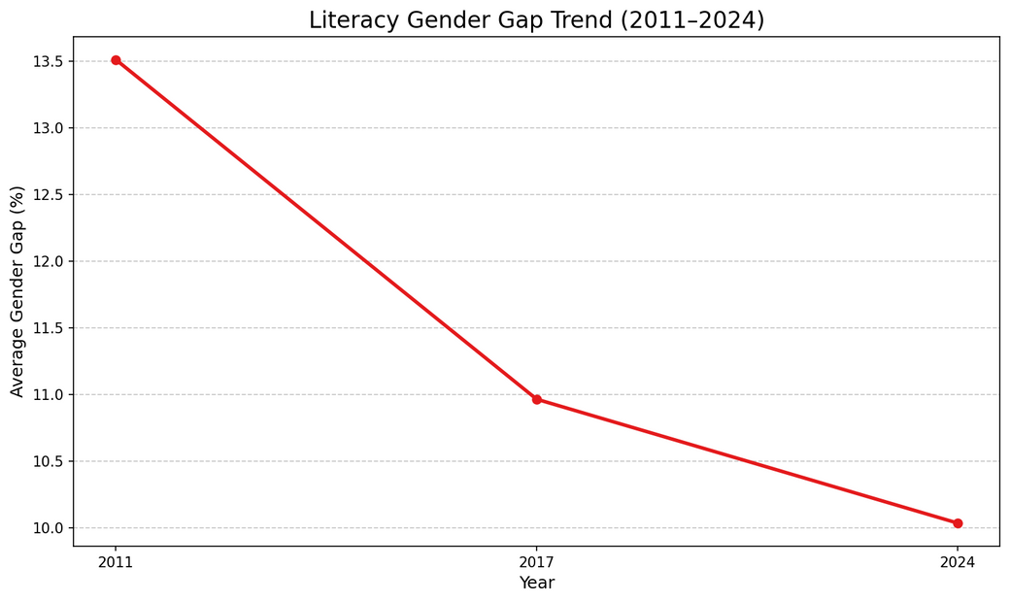
SHOW MALE VS FEMALE LITERACY AND GAPS
Visuals:
Average Male vs Female Literacy Rate by Survey
Literacy Gender Gap Trend (2011–2024)

Slide 9
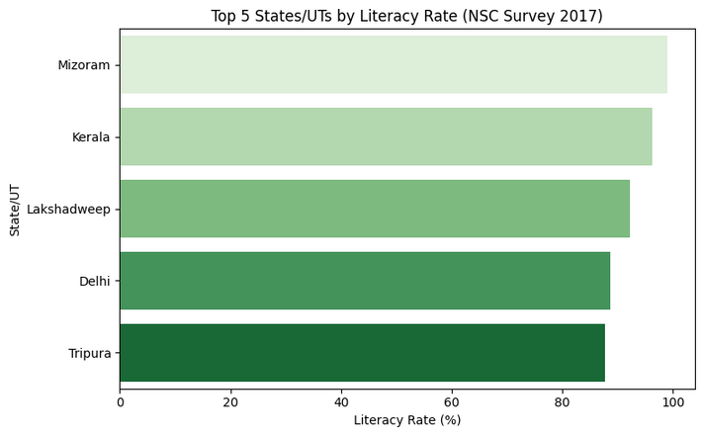
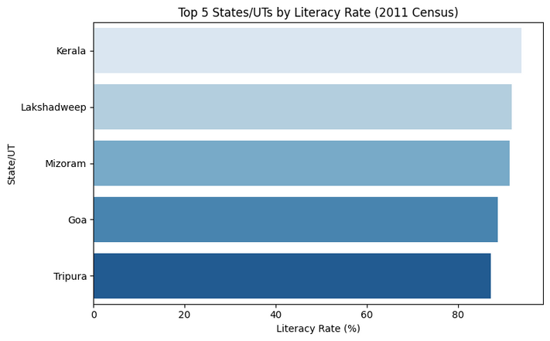
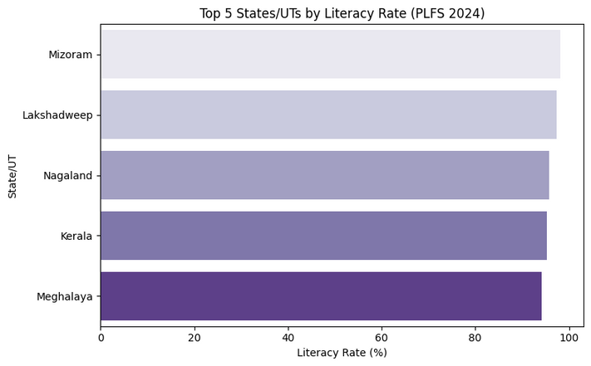
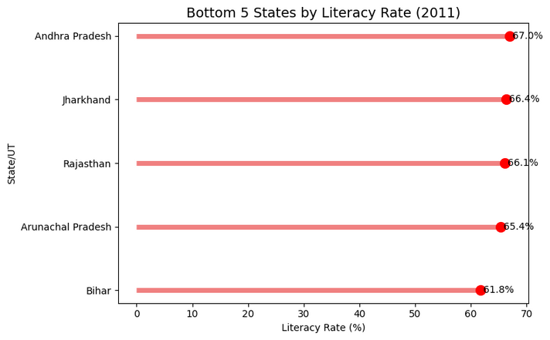
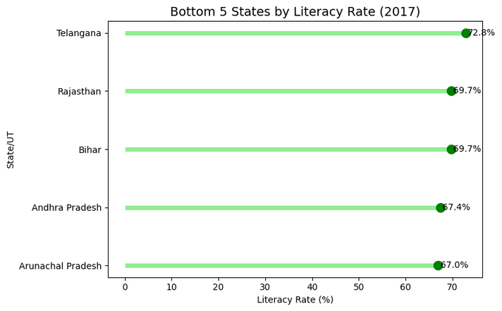
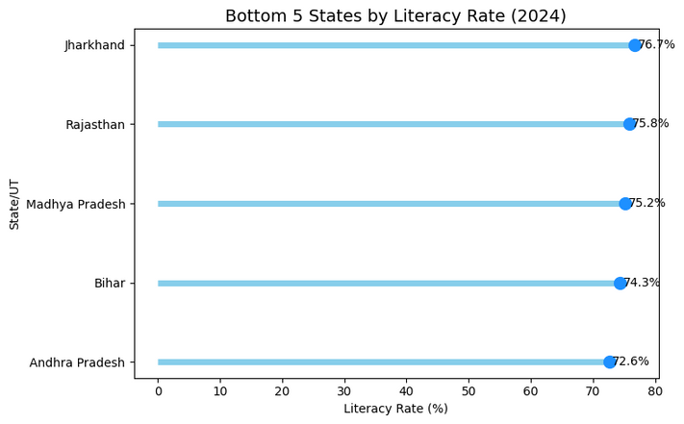
State Performance
Top 5 States/UTs Literacy Rate Comparison (Horizontal Bar Chart)
Bottom 5 States/UTs Literacy Rate Comparison (Lollipop Chart)

Slide 10
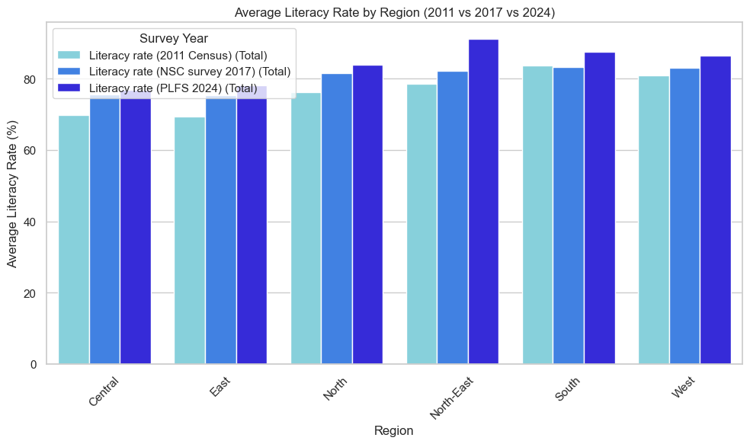
Regional & State Literacy Insights
Visuals:
Horizontal Bar Charts: Total, Male, Female Literacy by State (2011, 2017, 2024)
Average Literacy Rate by Region

Slide 11
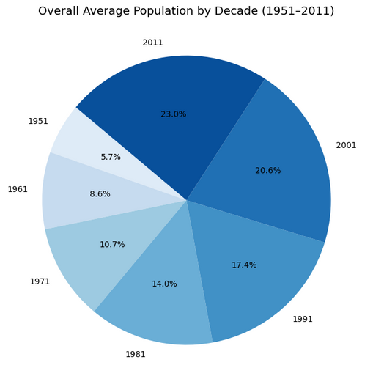
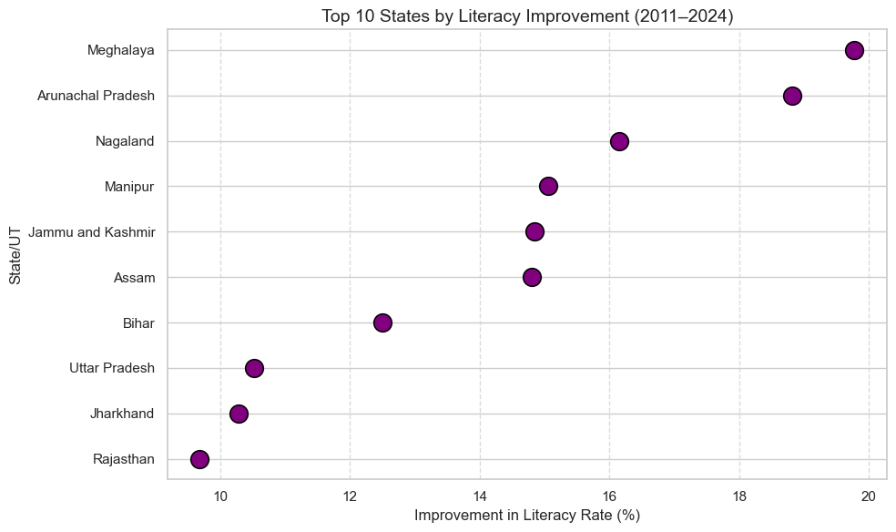
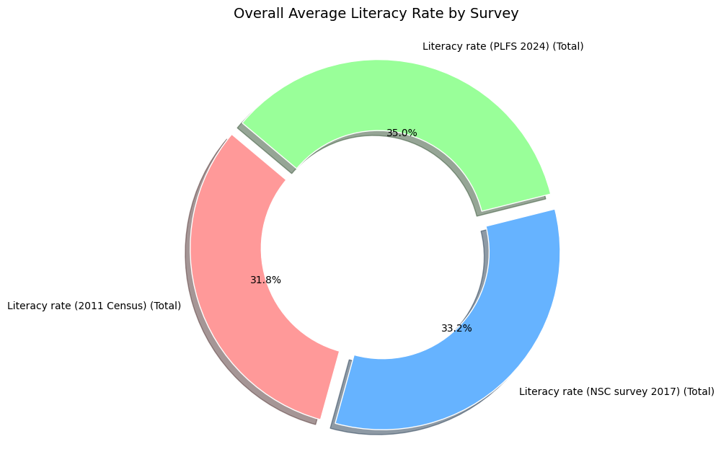
Top 10 States by Literacy Improvement (2011–2024) (Scatter Plot)
Overall Average Population by
Decade (1951–2024)

Slide 12

Conclusion
Successfully scraped and consolidated literacy rate data for Indian states/UTs from Wikipedia.
Cleaned, standardized, and processed the dataset for accurate analysis.
Generated visualizations and interactive maps to highlight trends, gender gaps, and state-wise improvements.
Provides a reusable framework for extracting, analyzing, and presenting structured data from web sources.

Slide 13

thank you
“Literacy is a bridge from misery to hope.”
– Kofi Annan

